Slide 1


HOSPITALITY ANALYSIS DASHBOARD PROJECT
Analyzing Key Metrics for Improved Hospitality Operations
Presented by Anjali Mourya

Slide 2

BUSINESS OBJECTIVE
1
AtliQ is a company that owns multiple hotel chains across various cities of India.
2
The Managing director / CEO of AtliQ wants to incorporate ‘Business and Data Intelligence’ to identify and track the source of revenue for AtliQ hotels
3
Hence, it is decided to develop a KPI Dashboard for AtliQ, using May-22 to July-22 data, which can help track its revenue sources and other relevant KPIs across various dimensions
4
It’ll help the management take strategic business decisions based on the insights generated from the
dashboard

Slide 3

SOLUTION APPROACH
There are 5 tables provided for tracking revenue, 3 dimension tables (date, hotel, room) and 2 fact tables (bookings, aggregated bookings)
Power BI was the tool used for creating the visualization/dashboard
The data was imported, analysed and transformed as per necessity within Power Query
The relationships between the tables were created within Power Pivot

Slide 4
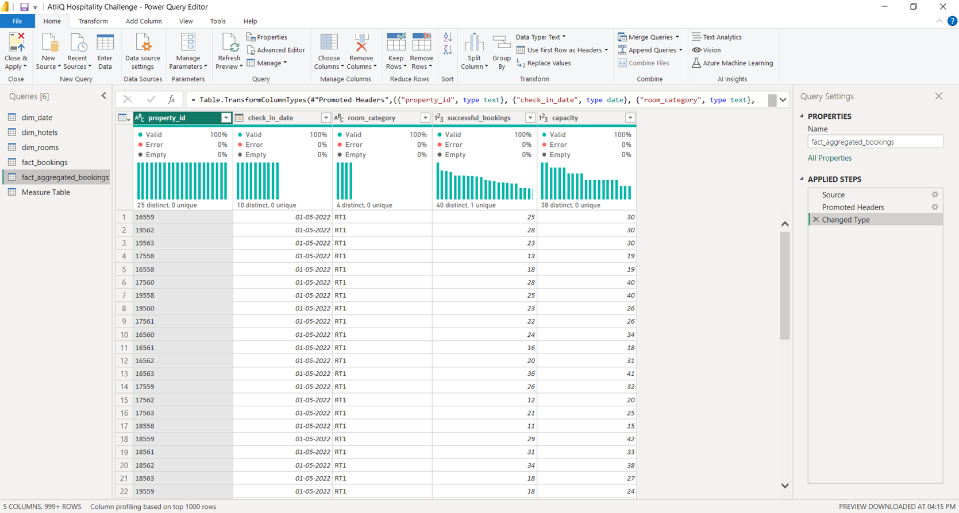

DATA CLEANING/TRANSFORMATION IN POWER QUERY

Slide 5
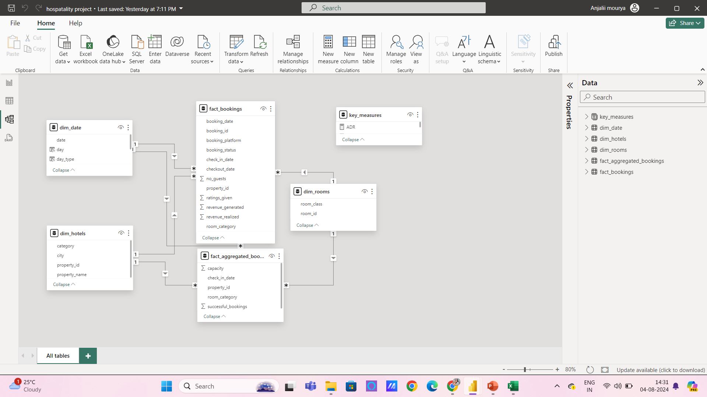

DATA MODELLING IN POWER PIVOT

Slide 6
SOLUTION APPROACH
few measures were created to calculate the KPIs as shown below:
Revenue = Sum of revenue_realized from Bookings table (in Rs.)
Total bookings = Count of booking_id from Bookings table
Avg rating = Average of ratings from Bookings table
Total capacity = Sum of capacity from Aggregated bookings table
Total successful bookings = Sum of successful bookings from Aggregated bookings table
Occupancy rate = Total successful bookings / Total capacity (in %)

Slide 7
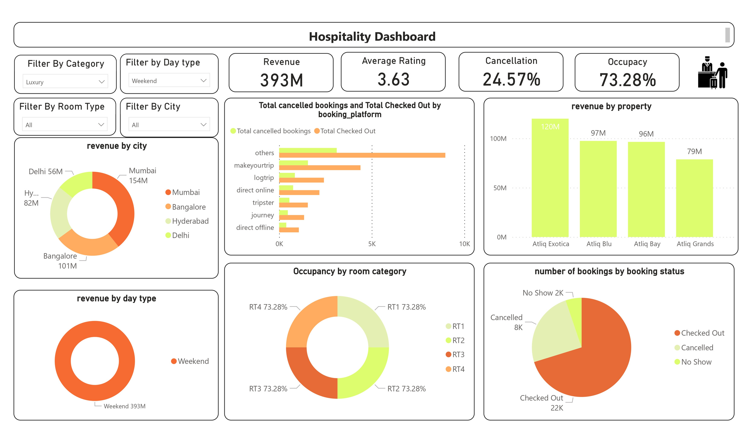

Slide 8
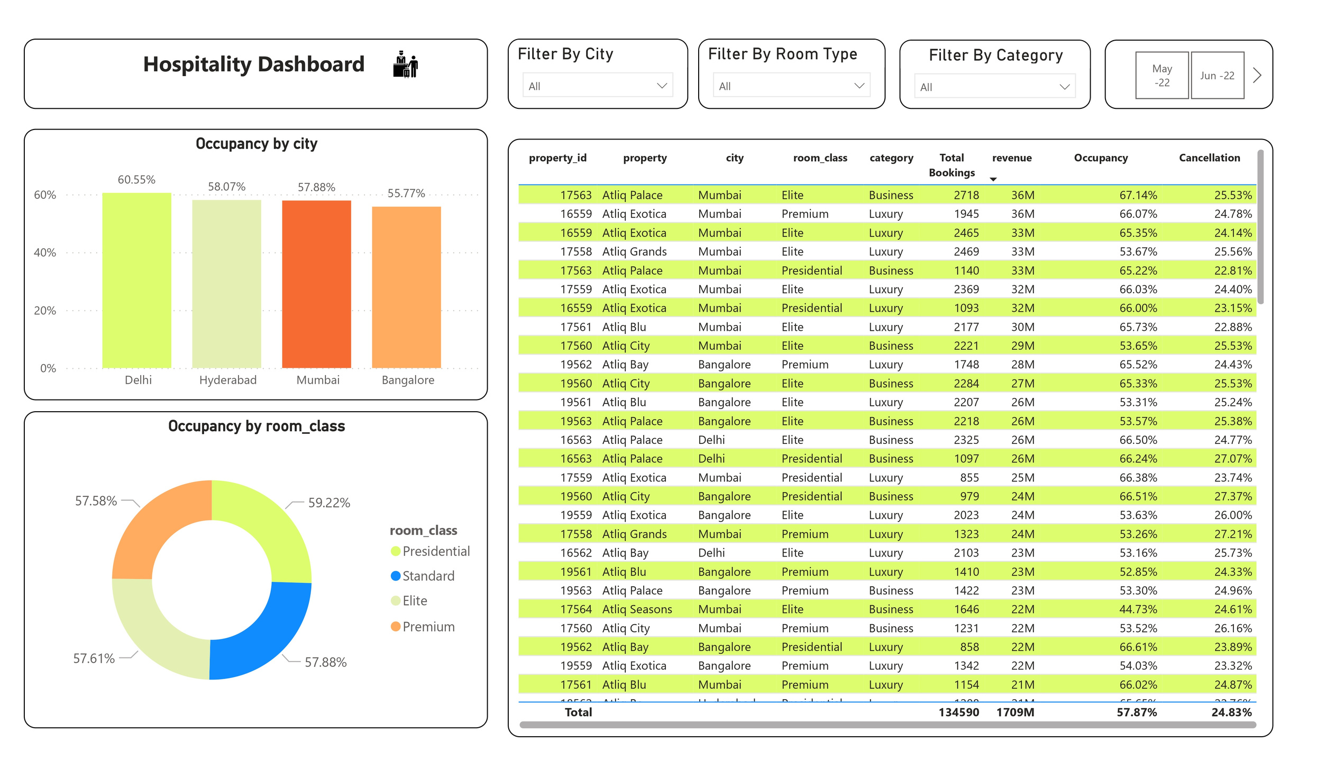

Slide 9
Features of the dashboard
Revenue by day type = Dough nut chart shows the distribution of revenue by room type
Revenue by city = Dough nut chart shows the distribution of revenue by room type
Occupacy rate by city = Stacked Column chart shows the distribution of occupacy by city
Occupacy rate by room class = Dough nut chart shows the distribution of occupacy by room class
Bookings by status = Pie chart shows the distribution of number of bookings based on booking status
KPI table = A matrix visual (pivot table) showing the various KPIs across cities and hotels in each city

Slide 10
Features of the dashboard
bunch of card visuals were placed in the left to show the values of important KPIs
The following filters were provided to slice and dice the data:
Month-year
City
Room type
Category
Day type
The visuals are interactive in nature

Slide 11
BUSINESS OUTCOMES
Mumbai generates highest revenue and Delhi the least revenue during May to Jul 2022. Company need to
focus on increasing the revenue in Delhi.
The occupancy rate is higher during weekends across all cities, months and booking platforms. Leverage
this insight to increase revenue generated during weekends.
70% of the bookings are checked out while 5% of booking don’t show up across all cities and booking
platforms which means 75% of bookings generate revenue for AtliQ hotels. Identify and analyze the reasons
for cancellations and try to reduce them.
Avg rating varies between 3.4 to 3.8 across cities and avg stay duration is 2.4 for each booking. Compare it
with the industry benchmark across cities and evaluate the performance.
Occupancy rate is highest at Delhi with 60+ % for all months though generates least revenue compared to other cities.
Identify the reason for higher occupancy and use that to drive the revenue growth.

Slide 12
CONCLUSIONS
A revenue dashboard was built for AtliQ hotels depicting its various KPIs visually
Relevant filters along with tooltips and interactions was provided in the dashboard
This dashboard can be used for both high-level and in-depth analysis of KPIs across various dimensions

Slide 13

THANK
YOU!

